Slide 1
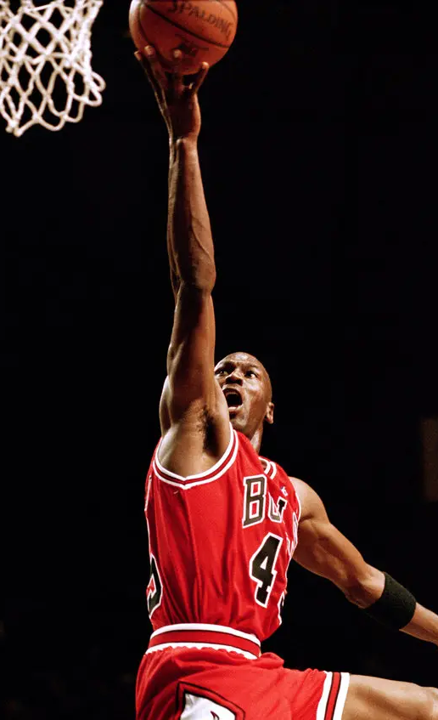

THE PHENOMENAL MICHAEL JORDAN: A CAREER IN NUMBERS
Team Name: 602161-U996LKA2

Slide 2

MICHAEL JORDAN: A CAREER OVERVIEW
Michael Jordan's Impact on the Game
Michael Jordan's Legacy
Michael Jordan's Records and Accomplishments
Michael Jordan's Opponents
Michael Jordan: A True Legend

Slide 3
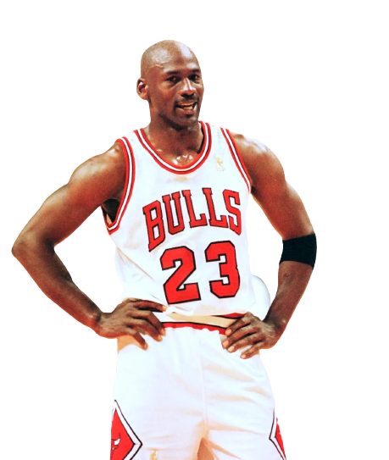
MICHAEL JORDAN'S CAREER OVERVIEW
Michael Jordan is one of the most iconic athletes of all time. His career spanned from 1984 to 2003, during which he achieved numerous accolades, including six NBA championships, five MVP awards, and 14 All-Star appearances. His career statistics are impressive, with an average of 30.1 points, 6.2 rebounds, and 5.3 assists per game.
Jordan was a talented defender as well, averaging 2.3 blocks and 1.7 steals per game. His field goal percentage was an impressive 49.7%, and he made 33.4% of his three-point shots. Jordan was also a reliable free throw shooter, making 84.5% of his attempts from the charity stripe.
MICHEAL JORDAN

Slide 4
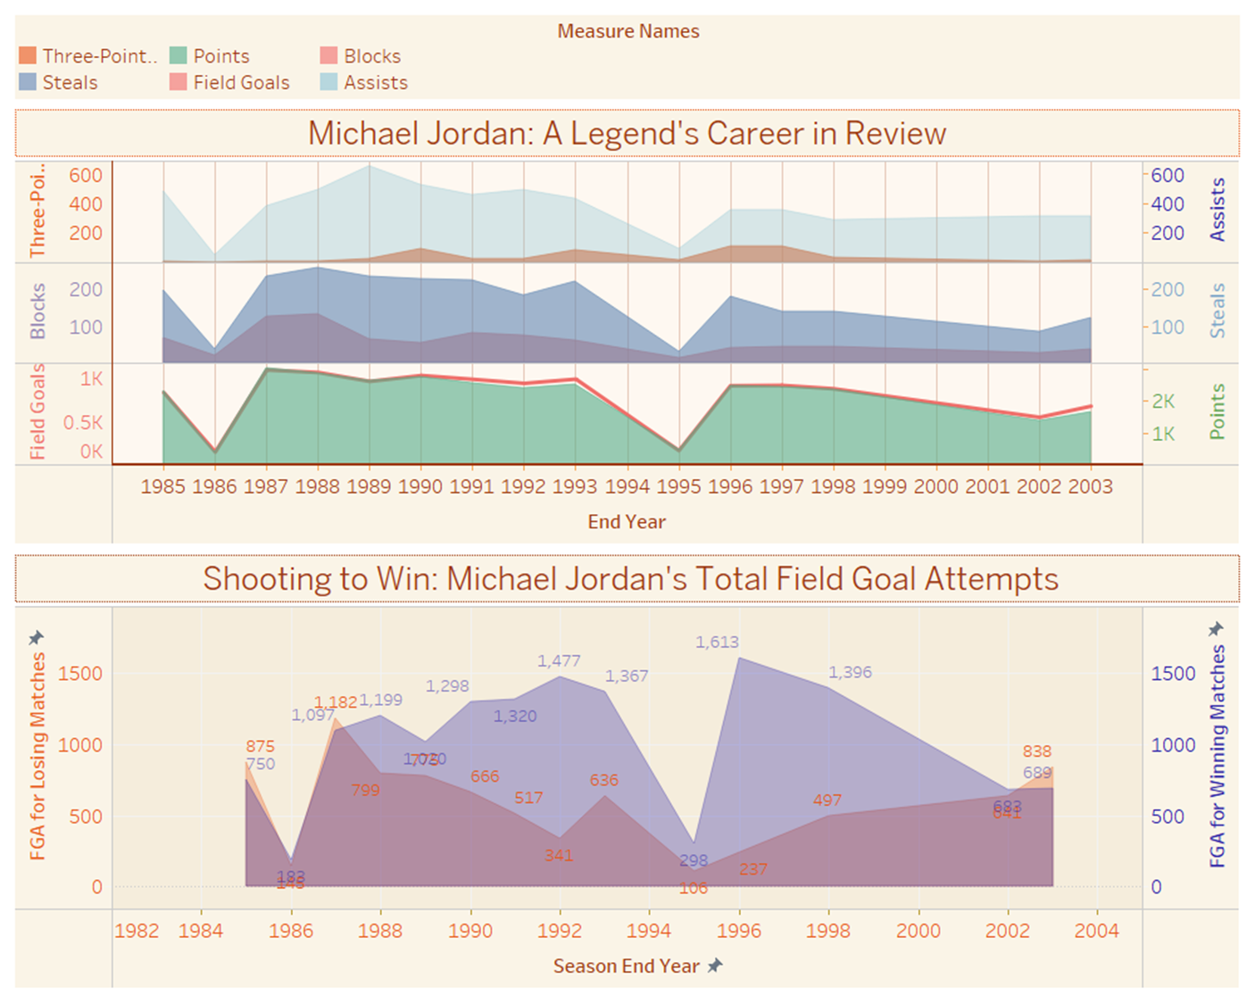
FROM ROOKIE TO CHAMPION: JORDAN'S CAREER AT A GLANCE

Slide 5
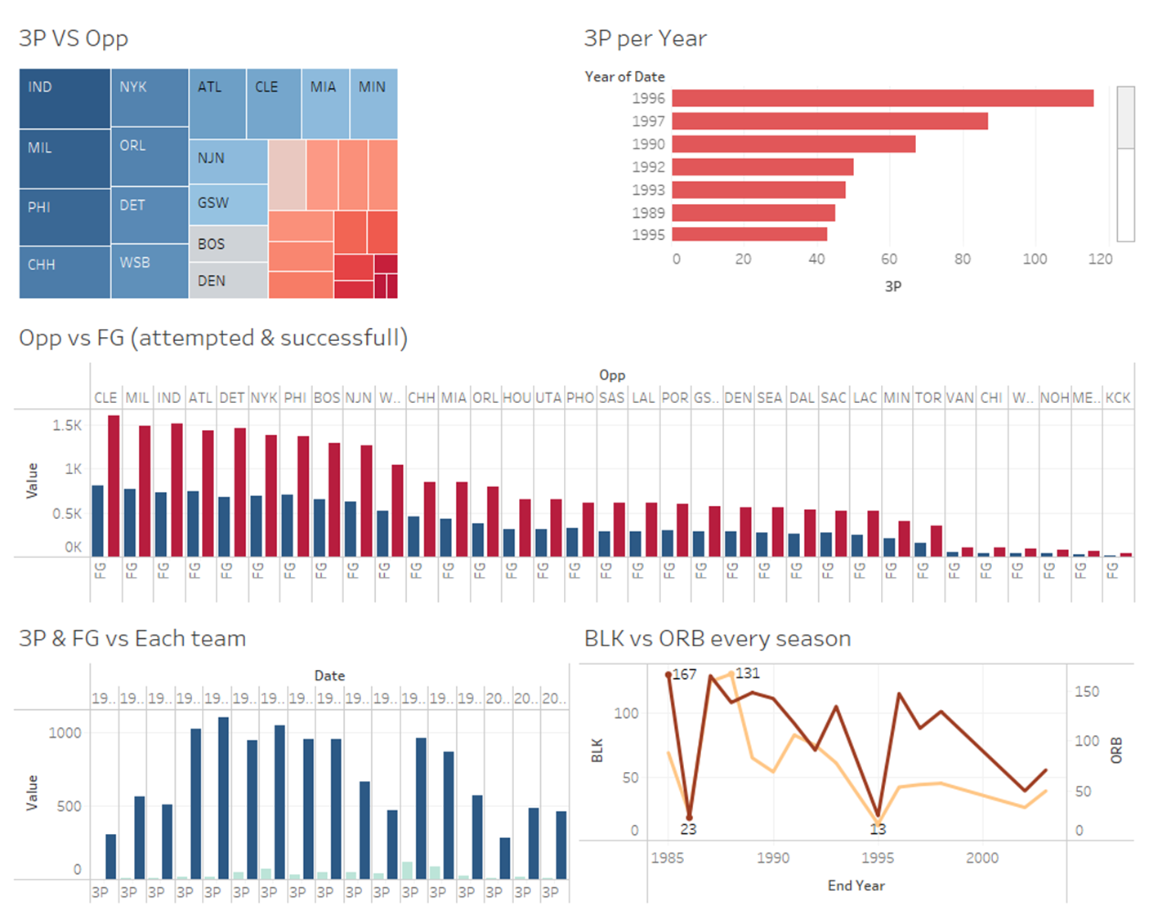
MICHAEL JORDAN'S IMPACT ON THE GAME
Michael Jordan's influence on basketball is unquestionable. He revolutionized the sport with his athleticism, competitiveness, and mental strategy. He also had a significant impact off the court, becoming a marketing icon and contributing to the global popularity of the NBA and basketball as a whole.

Slide 6
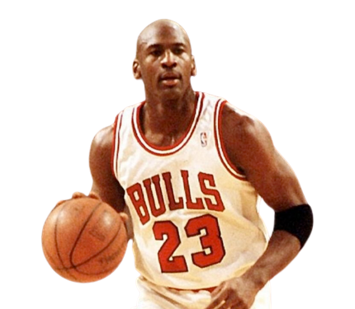
MICHAEL JORDAN'S
RECORDS & ACCOMPLISHMENTS
Michael Jordan is one of the most iconic athletes of all time. His career spanned from 1984 to 2003, during which he achieved numerous accolades, including six NBA championships, five MVP awards, and 14 All-Star appearances. His career statistics are impressive, with an average of 30.1 points, 6.2 rebounds, and 5.3 assists per game.
Jordan was a talented defender as well, averaging 2.3 blocks and 1.7 steals per game. His field goal percentage was an impressive 49.7%, and he made 33.4% of his three-point shots. Jordan was also a reliable free throw shooter, making 84.5% of his attempts from the charity stripe.
MICHEAL JORDAN

Slide 7
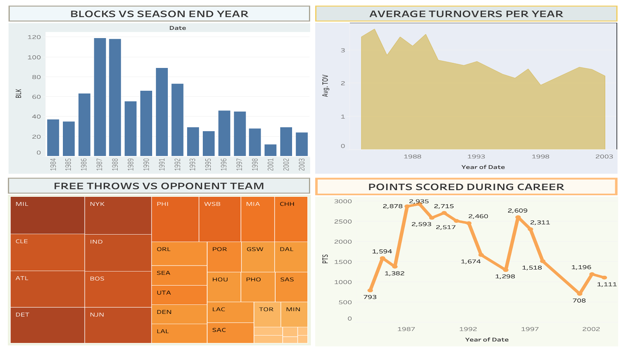

Slide 8
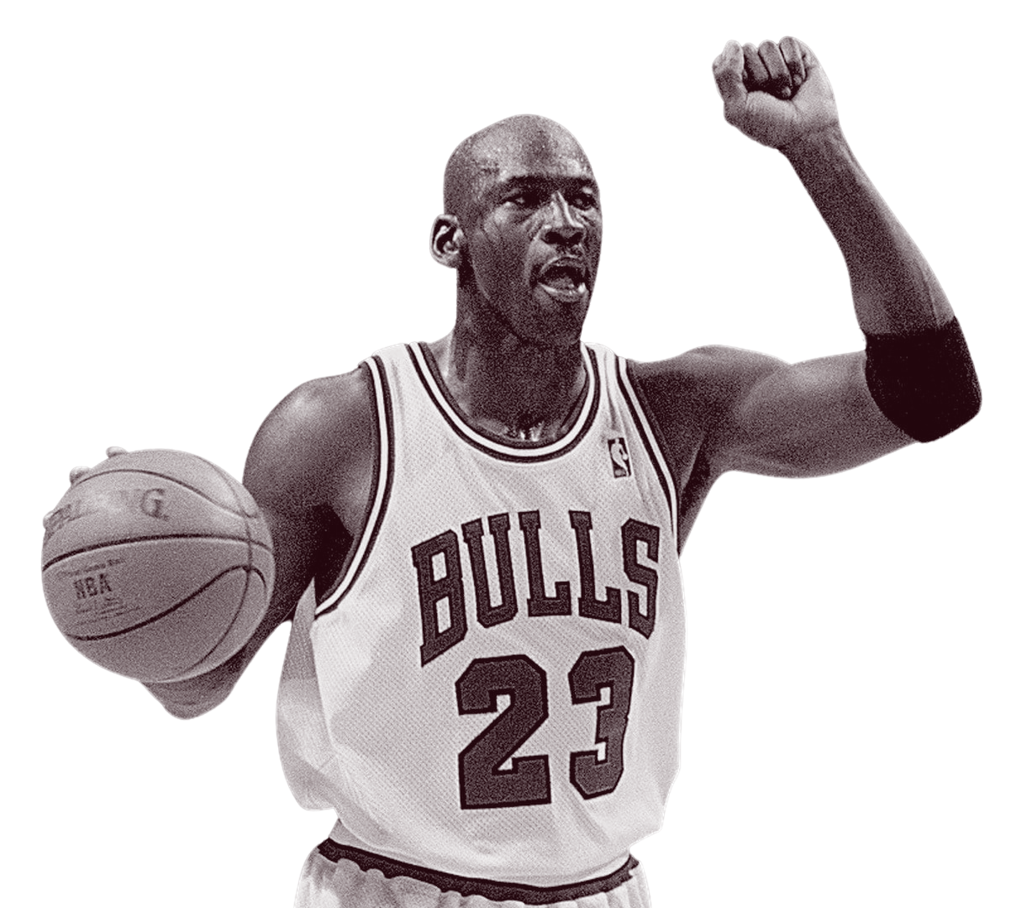

THANK
YOU.
THANK YOU!
TEAM NAME: 602161-U996LKA2

